Slide 1
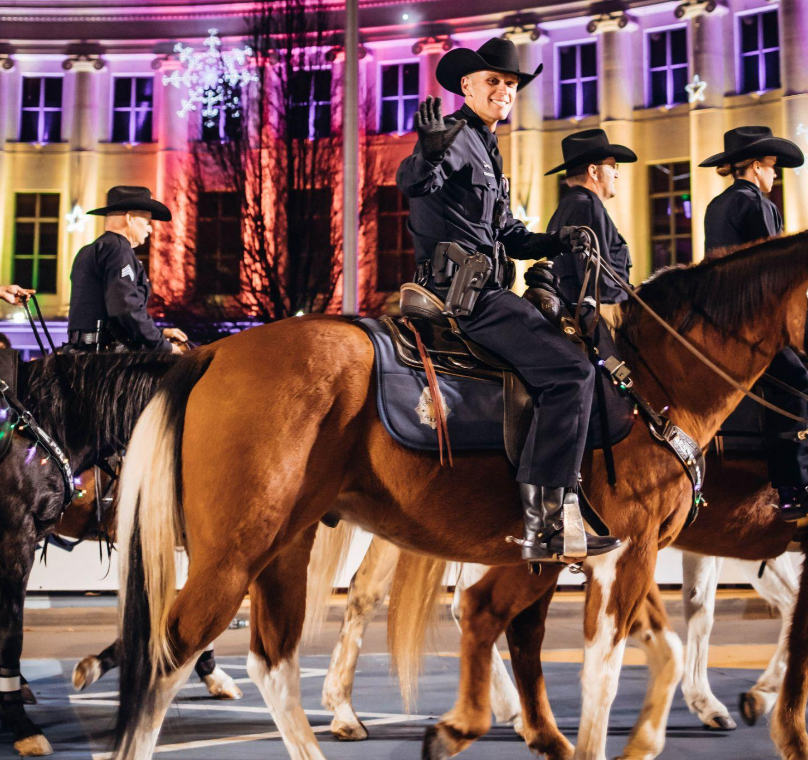
2022 Sponsorship Opportunities
The Downtown Denver Partnership produces this free holiday spectacular, featuring more than 40 units including extravagantly illuminated floats, giant helium-filled character balloons, magnificent marching bands, traditional equestrian units, and vibrant cultural displays. The parade kicks off the holiday season in Downtown Denver.
We aim to continue building a more inclusive center city that helps support downtown businesses, while also sharing the uniqueness and vibrancy of Downtown Denver with residents and visitors from near and far.

Slide 2
Overall Reach and Visibility
42.3k
Instagram Fans
8,000+
Facebook Fans
95,000+
Pedestrians Downtown along the route on Parade night
76,000+
Impressions on English Social Ad
225,000+
Pedestrians Downtown over the three weeks for stationary Parade
55,000+
Impressions on Spanish Social Ad

Slide 3
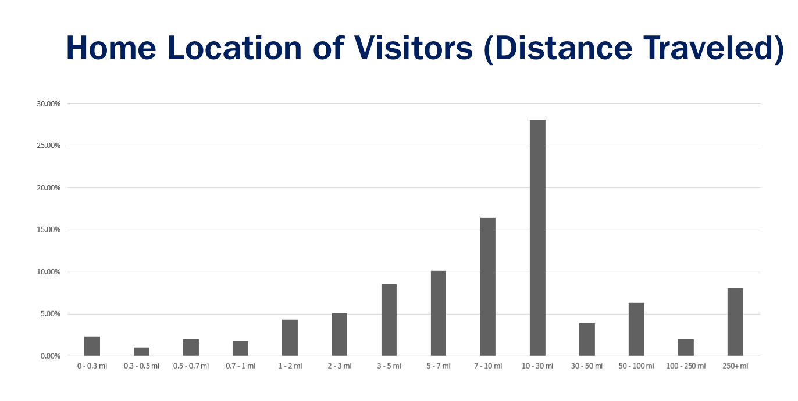
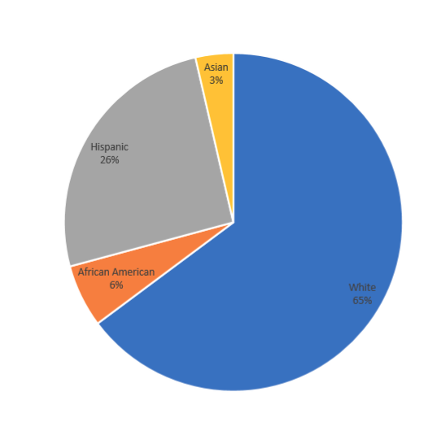
Who are our visitors and where did they come from?
Racial Composition
of Visitors (Est)​

Slide 4
Dec. 4 Telecast
139,866
Total telecast viewers
Colorado's biggest holiday parade is returned to the Mile High City. The 47th annual 9NEWS Parade of Lights brought sparkling lights, marching bands, giant balloons and colorful floats to the streets of Downtown Denver on Saturday, Dec. 4.
24,929
Live and on-demand for site and YouTube
Notes:
Waiting on numbers from jackie

Slide 5
2021 Webpage Performance
Nov. 27, 2021-Jan. 2, 2022
323%
Increase in POL
Page Traffic
177%
Increase in DDP Site Traffic
74,000+
Total POL Page Views
51,000+
Unique POL
Page Views
35%
Of all DDP Website Traffic

Slide 6
Media Coverage
Free museum days, ice skating, a campy Christmas and more things to do this weekend in Denver
10 over-the-top Colorado holiday light displays you have to see this season
9Things to do in Denver and Colorado this weekend
9Things to do in Colorado this weekend: Dec. 3-5
WATCH: 9NEWS Parade of Lights
Volunteers needed for 9NEWS Parade of Lights
Denver Police Prepare To Protect The More Than 100,000 People Expected Downtown For Parade Of Lights
Season's Greetings: All the Holiday Events in Denver
Ten More Things to Do in Denver This Weekend
31 Things To Do in and Around Denver This Weekend

Slide 7
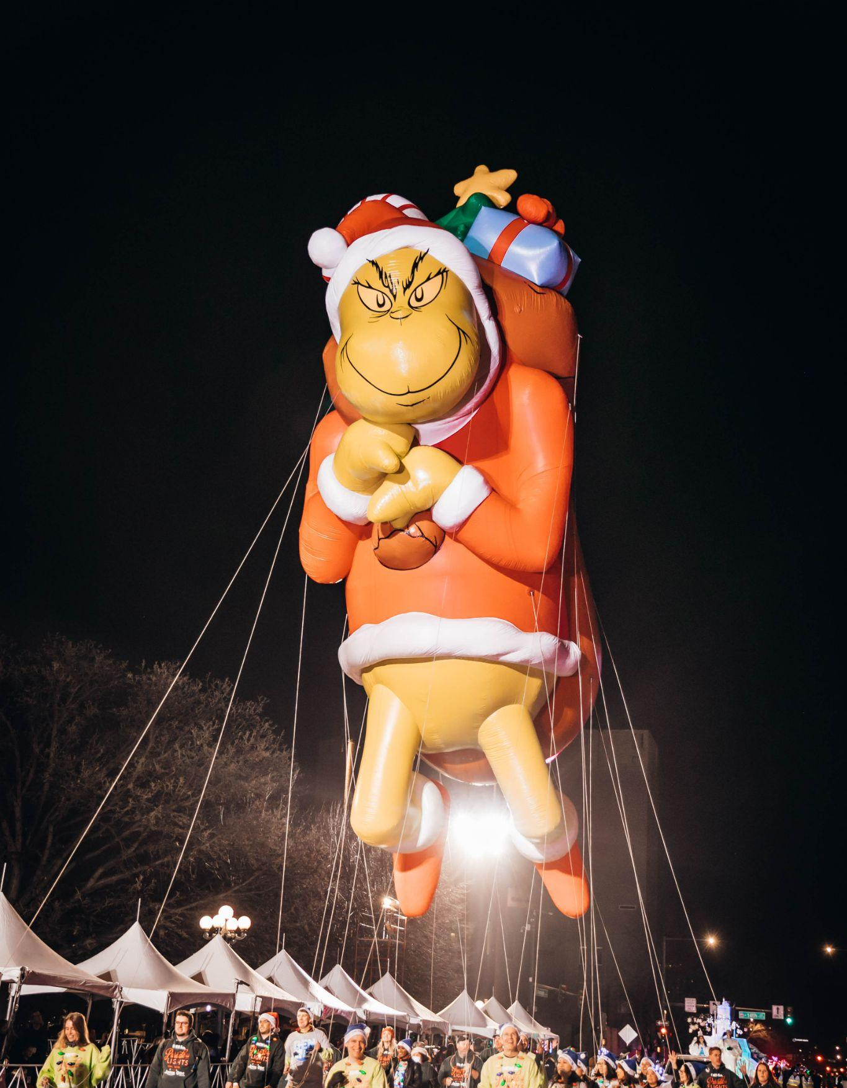
Sponsorship Levels
Parade of Lights
Marching Band Sponsor - $30,000
Cultural Group Sponsor - $25,000
Float Sponsor - $17,000
Balloon Sponsor - $16,000
Benefits to include (but not limited to):
Licensing Rights
Presentation Rights and Recognition
Promotional Rights
9NEWS Special Prime Time Telecast
Social Media Engagement
Digital Marketing Benefits

Slide 8
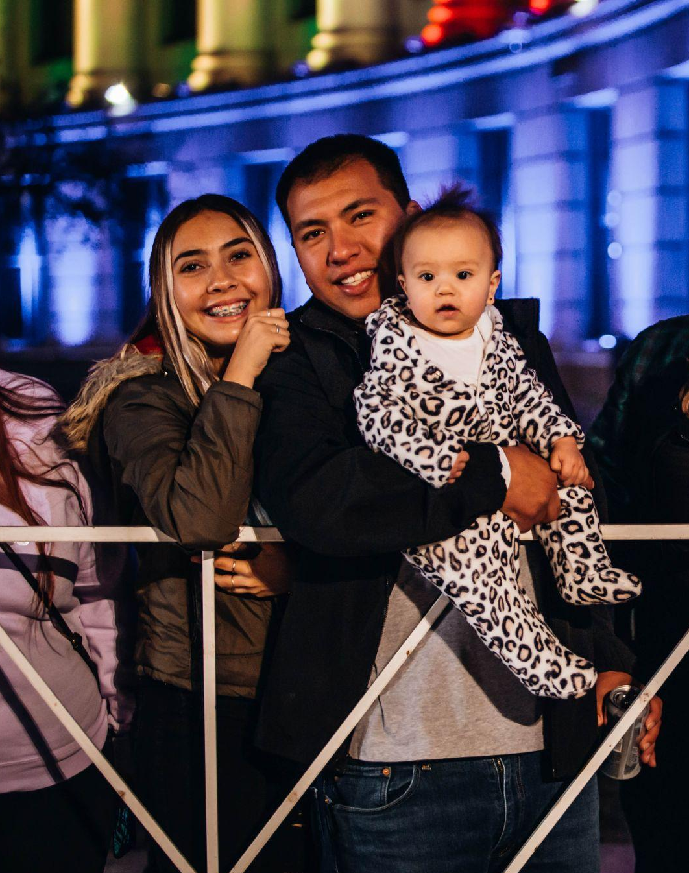
$5,000
Event Sponsor
Parade of Lights
Your company Logo will appear on event website, mobile app, event posters onsite from Dec 4 – 26th
Name will appear on the 9News Telecast on Event Sponsor screen.
Can send up to 10 employees to volunteer as walkers in the parade.

